Slide 1
The integration of National Competency Standards into TVET Stream’s Programs on students’ readiness for employment and transitioning to PSET.
Ministry of Education Sports and Culture

Slide 2
Focus of presentation
Resources
Relevance
Quality
Relevance of TVET programs
Quality of School Programs
Improvement of Resources in Schools
Notes:
3 main areas MESC is asked to speak about to highlight relevance, quality and resourcing of TVET in schools

Slide 3
Background of TVET Study, Analysis, Policy and Reforms
Since 2004
2014
2017
2018
TVET subjects offered as part of the general curriculum from Year 9-Year 13
Feasibility Study of TVET commissioned by AUSAID
Evaluation and Analysis of TVET curriculum commissioned by MESC
National School Technical and Vocational Education and Training (TVET Policy)
2020
4 YEAR LEVEL approved by Cabinet for Implementation (2021-2024)
Notes:
Historically TVET subjects were taught as a general subject from year 9-year 13 for students who choose to explore TVET. TVET curriculum was part of the general curriculum and each subject has its own individual curriculum statement. The following studies in 2014- 2017 informed the development of the TVET Policy in 2018, and later in 2019 the development of the 4 year level.

Slide 4
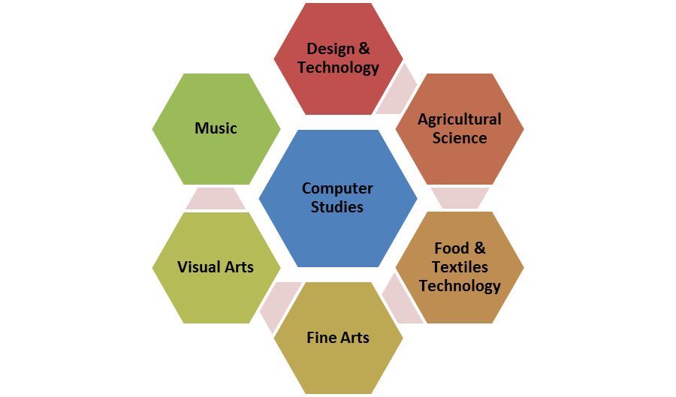
1. Relevance of TVET programmes
Feasibility Study in 2014 & Evaluation and Analysis of TVET curriculum 2017 concluded that “ TVET subjects were outdated and irrelevant to the needs of labour market”
2014-2020 TVET subjects offered as part of the general secondary curriculum Year 9-Year 13
Notes:
Relevance as defined in the Ministries TVET Policy is “TVET programmes that are aligned with national priorities, support personal and professional development and meet societal andlabour market demands.
The outcome of the Feasibility study commissioned by AUSAID in 2014 and Evaluation Analysis in 2017 has informed the development of the Ministries TVET Policy addressing through it’s Policy areas TVET issues and concerns identified in the studies of 2014-2017. This has further amalgamated the development of the new four year level focusing on relevance through TVET pathways offered at Year 9 and specializing at Year 10-Year 12.

Slide 5
Addressing Relevance in TVET for schools as per National TVET Policy 2018-2023
Flexible Pathways in TVET programs & curriculum deliver to labour market needs
Re-packaging of Curriculum & Assessment
Upgrade Of Teachers and TVET Professionals
ICT in TVET enable access of e-learning
Effective Governance and Partner Support to strengthen TVET
Participation of Females in TVET programs
Sustainability of Resources
Educating Parents
Notes:
There are 11 policy areas in the MESC National TVET Policy used by MESC to address TVET in schools only 8 are highlighted in this presentation. All of the above 8 are now either in place, working towards development of part and parcel of the on-going support provided by TDAD and Curriculum or ICT divisions. Others addressed through the OGG .

Slide 6
In line with the Sector (MEL) Monitoring Evaluation & Learning KPI the Ministry is expected to achieve a :
“certain % of Government secondary schools providing at least 3 repackaged TVET programs “
By 2020 98% of Colleges offer a TVET subject/s with only 2% not offering any TVET subjects at year 12 & year 13
Data for 2020 shows that the number of students opting for a suite of TVET subjects increase across all subjects by Year 13 compared to Year 12.
It is an indication that more students are trending towards TVET pathways

Slide 7
Addressing Relevance in TVET Pathways through the new Four Year Level (4YL)
FOUR LEARNING AREAS/PATHWAYS
ARTS
Year 10-Year 12
COMMERCE
Year 10-Year 12
TVET
Year 10-Year 12
SCIENCE (General Science/Pure Science)
Year 10-Year 12
Year 9
Remains the same as the existing compulsory subjects: English Math's, Samoan
Science, Social Studies,
Choose from below subjects relevant to pathway in Year 10
Computer Studies, FTT, Music, Agricultural Science, DT, HPE, Visual Arts
English
General Math's/Math’s
History
Geography
Choose from
Visual Art, Computer Studies, Music/Performing Arts, Visual Arts, HPE.
Communication English
General Math's
Samoan
Choose from below
Computer Studies, FTT, DT, Geography, Ag Science, Music/Performing Arts, HPE, Visual Arts.
English/Communication English
Math's/General/Math’s
Accounting, Economics,
Choose from below
Computer Studies, FTT,
V- Arts, Agriculture Science, Design Technology, Music/Performing Arts , Health PE
Pure Science
English, Math's,
Choose from below
Biology, Chemistry, Physics,
Choose others below
Samoan, Computer Studies, Music
General Science
English, General Math's, Samoan
Choose from below
Computer Studies, FTT, DT, Agricultural Science, Music & Visual Arts
Phase 1: Review of TVET curriculum to align with learning and career pathways (2016-2020)
Phase 2: Re-packaging of TVET courses (2021-2023)
Phase 3: Introduction of repackaged TVET courses in 4 Year Level
(2024-2027)
Notes:
The development of the 4 year level gives emphasis to TVET learning pathways and drawing the link between college and higher education (Foundation) and or Post secondary education. The Ministry’s role is to ensure that students are equipped with the core knowledge and skills to further education through NUS or SQA and or APTC. This includes the repackaging of TVET courses already in the pipeline for discussion with SQA.

Slide 8
TVET Pathways to NUS and PSET
TVET PATHWAY
TVET
NUS
Certificate in Nursing (FON) Primary Education (FOE) Certificate TVET or Vocational,
NUS/TERTIRAY OR POST SECONDARY EDUCATION & TRAINING
B.Ed Primary Education (FOE)
Or
Technical/Vocational
PSET PROVIDERS
Area for discussion
- re-packaging TVET courses at Year 10-13
- Certificate level accreditation for Year 10-Year 12 students to enter at PSET levels and or NUS
- BEST PRACTICE MODULE to be adapted for Secondary students
Year 2021-2023
Notes:
4 YEAR LEVEL will ensure that TVET pathways are in line with NUS OR PSET provider standards and or accreditation systems in place to empower relevance and quality. This is the intent of the 4 yearlevel including the 2 stream of Math's, English relevance to TVET students so that they are able to pursue Vocational at the Higher level and PSET LEVELS.

Slide 9
2. Quality of School Programs
Qualified Teachers
Scholarship for qualification including TVET in place
Sponsorships for up-grade programs targeting TVET areas
Teacher training on TVET specific subjects on-going in collaboration with NUS lecturers
E- learning platforms to develop resources
Live streaming and use of ICT
Enforced through MSS
Colleges in taking TVET subjects must have adequate TVET workshops
Funded through OGG
Resources/workshops/classrooms
Accreditation
2021-2023
Discussions between SQA and MESC for the re-packaging of TVET courses incorporating SQA standards for accreditation
Certificate Level accreditation

Slide 10
3. Improving resources in schools
Curriculum statements
Teachers Manuals
Training of Teachers
Professional Developments
Student Text books
Teacher support
Moodle and Zoom
On-line resources
Television Programs
Web-site
One Government Grant to fund resources and classroom needs
Notes:
These are ALL continuous efforts and development in place by MESC to support the resourcing of schools in preparing themselves for TVET education in college.

Slide 11
Building better TVET pathways lies in our SECTORIAL efforts in addressing issues as a Sector and changing mindsets toward TVET by sharing ideas, & best practices
This forum is an excellent opportunity for it
Manuia ma ia soifua

